Slide 1
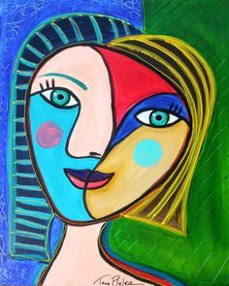

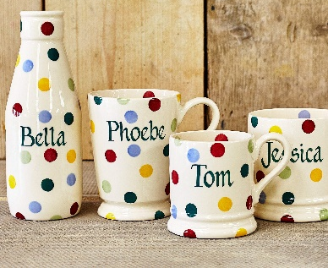
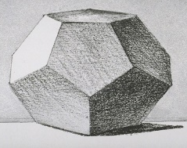

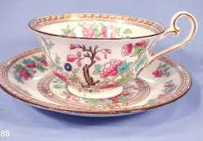
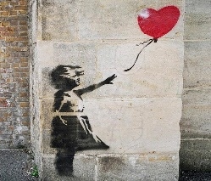


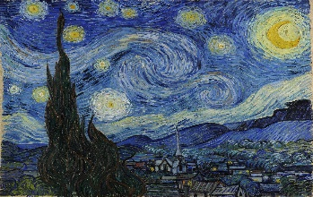
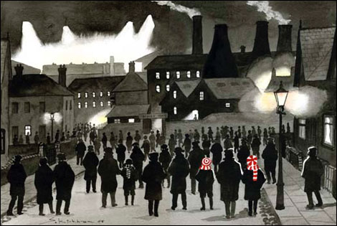
My Art & Design Journey
Expressive Arts and Design:
In EYFS the children explore a variety of materials, tools and techniques, experimenting with colour, design, texture, form and function. They share their creations, explaining the process they have used, preparing them for the National Curriculum.
How does Picasso show emotion in his artwork?
What are the primary and secondary colours?
Can you create Art using materials?
How do artists create tone?
What colours are used create a tint?
What kind of Art is made in Stoke-on-Trent?
Early Years
Key Stage 1
Year 1
Year 2
Describe LS Lowry’s industrial movement
How can colour block printing create different pattern effects?
Compare Royal Doulton and Wedgewood
Children will learn to think like artists.
Key Stage 2
Year 4
Year 3
How does shading and texture create a 3D effect?
How can you add a background wash to a painting?
Is graffiti Art?
Do artists come from Stoke?
Did Vincent Van Gough’s work impress everyone?
How can we edit photos to create a mood effect?
Year 5
Year 6
As children progress, they will learn how art and design both reflect and shape our history, and contribute to the culture, creativity and wealth of our nation.
Is Sid Kirkham’s artwork similar to Lowry?
Name famous sculptures from Stoke –on –Trent.
How did Lubaina Himid explore social and cultural issues in her artwork?

