Slide 1

First Holy Communion
Eucharist
Sacrament of Initiation

Slide 2
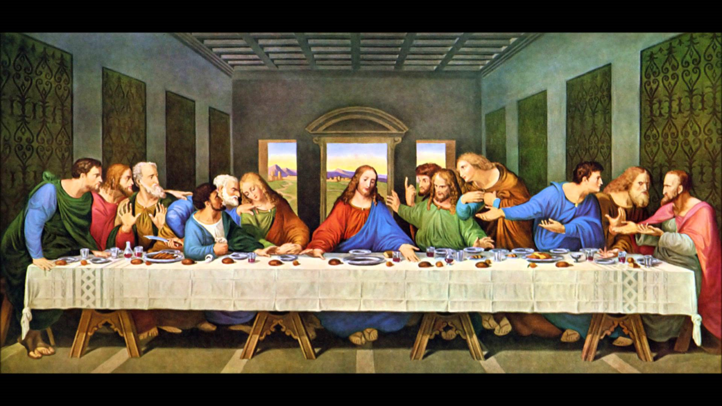
The Last Supper
Luke 22:7-23

Slide 3
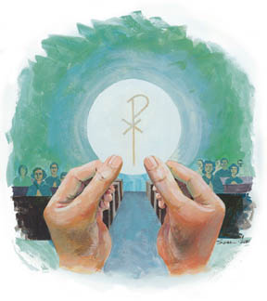
When do we hear these words?
And he took bread, gave thanks and broke it, and gave it to them, saying, “This is my body given for you; do this in remembrance of me.”
In the same way, after the supper he took the cup, saying, “This cup is the new covenant in my blood, which is poured out for you.

Slide 4
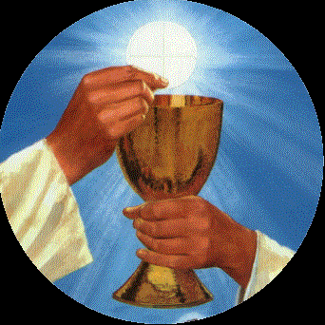
What is the Eucharist?
We believe that the bread and wine that is offered is the actual body and blood of Christ and another form of sacrifice. They believe that although the bread and wine physically remain the same, it is transformed beyond human comprehension into the body, blood soul and divinity of Jesus. This is called Transubstantiation and is celebrated in the festival of Corpus Christi.
The Eucharist is the most important act of worship. All Roman Catholics are encouraged to receive communion at least once a week during Mass. Some practising Catholics may receive the Eucharist every day.

Slide 5
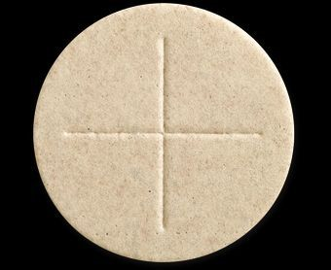
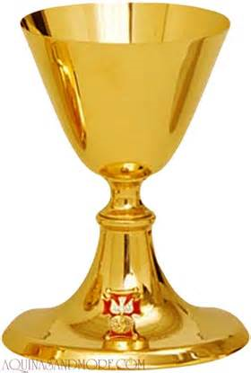
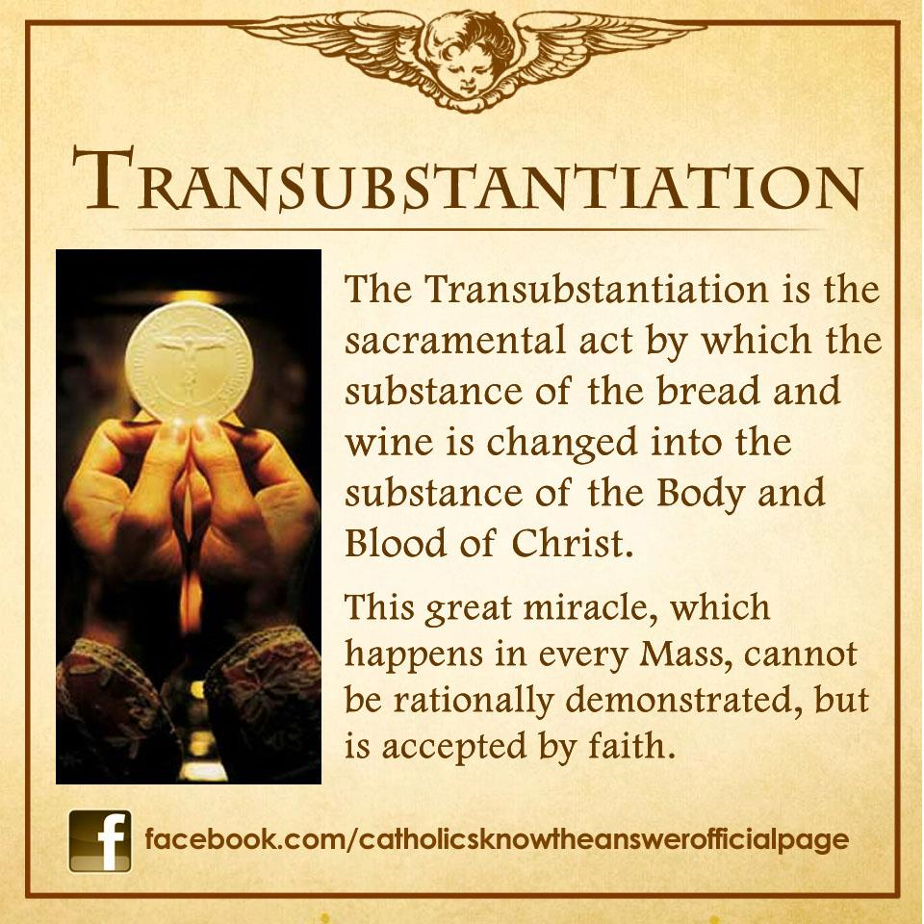
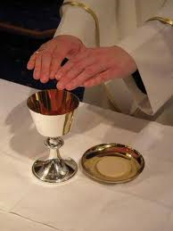
Host
Chalice
Consecrated

Slide 6
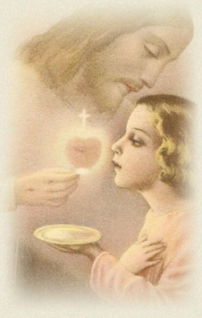
What is happening when we receive the Holy Eucharist?
Spiritual Food.
"The Eucharist is a meal. On the table of the altar, Jesus feeds us with his Body and Blood, under the appearances of bread and wine."
"Just as food nourishes our bodies, the Eucharist is spiritual food that nourishes our soul."
Real Presence.
"We like to be around friends, and our love for them grows when we're with them."
"Jesus called us friends, and in the Eucharist he made it possible for us to be with him (see John 15:15)."
"Jesus is really present in the Eucharist under the forms of bread and wine."
"When we celebrate the Eucharist and spend time in Jesus' presence, our love for him grows.

Slide 7
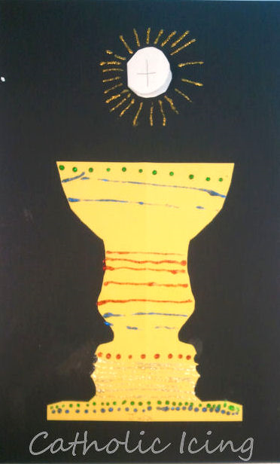
With your parents…
Create your own chalice and Host.
Think about how you will grow and change from receiving your First Holy Communion.

Slide 8
St Teresa of Avila wrote about in her famous poem:
Christ has no body now on earth but yours, no hands but yours, no feet but yours.
Yours are the eyes through which is to shine Christ’s compassion in the world.
Yours are the feet through which to go about doing good.
Yours are the hands with which he is to bless all people now.
Write your own reflection using this poem to help you.

Slide 9
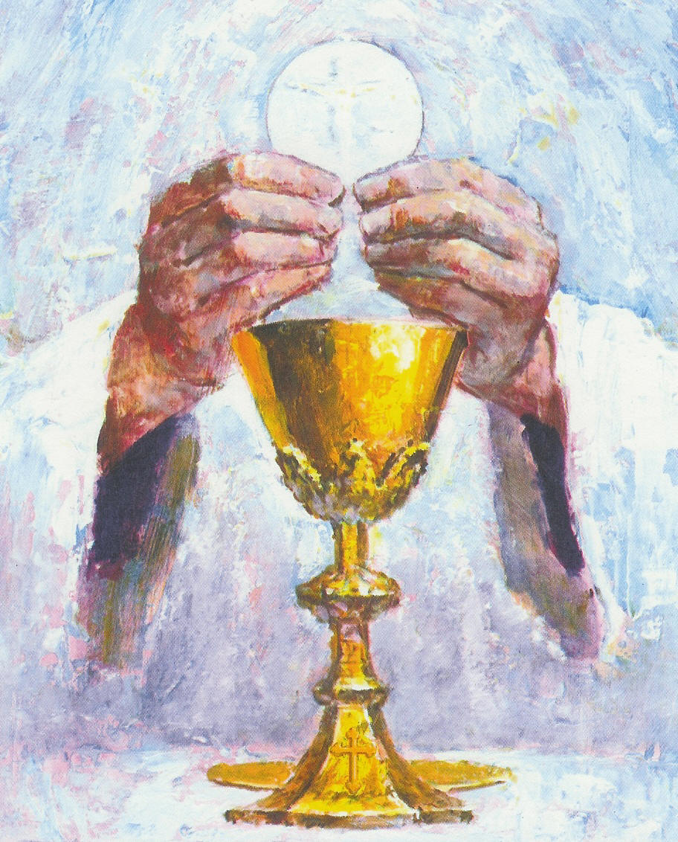
Arrangements:
First Holy Communion –
Photographer will be in Church before – please arrive with children between 10 and 10:30 so that we can get all of the photographs before Mass.
Girls wear white dress
Boys – Dark trousers (grey school or black) white shirt, red tie (have been ordered through the office)
There will be light refreshments after Mass (Tea, Coffee, Cake)
Please practise any readings that are sent home.

